Slide 1
Evidence of Evolution
Comparative Biochemistry and Anatomy

Slide 2
Comparative Biochemistry
DNA
Protein Sequences

Slide 3
DNA
Sequences of bases in DNA varies per species and per individual
Sequences of the DNA phosphate bases are compared between two species
The more similarities in the sequences they have, the more closely related they are. Meaning that they have a close common ancestor.
After speciation occur, the new species would have very similar DNA and would gradually change trough the process of speciation
Closely related species would have very similar DNA profiles- showing evidence of a common ancestor
Example: Chimpanzees, human’s closest living relatives
Humans share 98% of their DNA with Chimpanzee
Evidence of a common ancestor

Slide 4
DNA: ‘Junk’ DNA
DNA sequences that does not code for anything
More closely related species share more junk sequences- evidence of these species evolving from a common ancestor
The more ‘junk’ DNA two species have the more closely related they are
Example: Endogenous Retrovirus
A viral sequence that has become part of an organism’s genome
A retrovirus inserts its RNA into a species DNA and has become part of the specie’s chromosomes. This will be inherited by the next generation
Humans and Chimpanzees have the same ERVs located in the short arm of chromosome 10 is also found in humans- evidence that chimpanzees and humans share a common ancestor

Slide 5
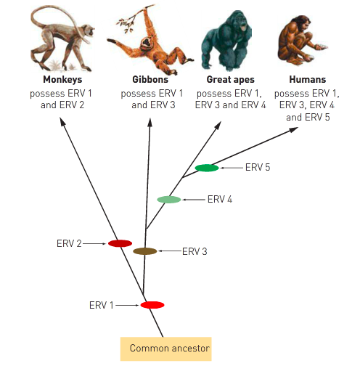

Slide 6
DNA: Mitochondrial DNA
Mitochondria contains DNA in small amounts
Advantages: easier to obtain and extract - most cells contains large numbers of mitochondria thus smaller samples can be used
Inherited from the mother- allows tracing of a direct genetic line
After fertilisation, the mitochondrial DNA of the sperm is destroyed
Most useful when comparing individuals within a species and for closely related species
If mitochondrial DNA is identical- two individuals could be siblings
If mitochondrial is very different- last common ancestor lived a long time ago
Example: Enabled to trace migration routes of ancient people
Showed that Europeans descended from hunter- gathers who migrated into Europe during the last Ice Age rather than coming from the middle east

Slide 7
Protein Sequences
Proteins: made up of long chains of amino acids
The more similar the sequence of amino acids for a protein in two species, shows how closely related theses species are.
Provide evidence that all organisms descended from a common ancestor
Degree of difference between proteins enables an estimate of the amount of evolution that has taken place since two species developed from a common ancestor: the greater the difference the longer the time involved
Ubiquitous Proteins: proteins that appear in all organisms - Carry the same function wherever they are found
Example: Cytochrome C
performs an essential step in production of cellular energy
Human Cytochrome C contains 104 amino acids
Regardless of species, 37 of these amino acids are found at the same position in every sequenced cytochrome C molecule
Suggest that these proteins have descended from an ancestral cytochrome C molecule found in primitive microbe that existed more than 200 million years ago
Cytochrome C of chimpanzees and humans differs by only one amino acid

Slide 8
Comparative Anatomy
Embryology
Homologous Structures
Vestigial organs

Slide 9
Embryology
Comparing the very early stages of the development of organisms
Embryos of related species are similar even when they develop into different looking animals- Suggests that they are descended from a single common ancestor
The more in common two species have in early stages of development- suggest that they are more closely related.
Example: The embryonic gill pouches and arches appear in all species
They do not provide function for species such as reptiles and birds that have lungs for breathing air
The presence of these structures are viewed as an evolutionary series that began with fish hundreds of million years ago

Slide 10
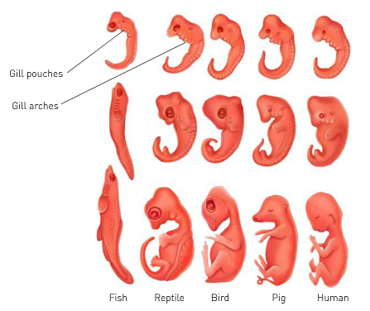

Slide 11
Homologous Structures
Structures that are similar in structure but are used in different ways
Same bones appear in various forms throughout the vertebrates
In every vertebrate, the bones are arranged in a similar way, even though some have developed different functions
Organisms possessing structures/organs that are similar in structure are likely to have a common ancestor
The more common structures two species have the more closely related they are.
Example: The forelimb bone
Arrangement of the bones of the forelimb are similar in different species
Provide evidence that they have all evolved from a common ancestor

Slide 12
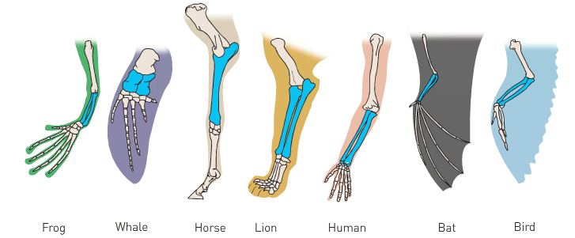

Slide 13
Vestigial Organs
Structures reduced in size that appears to have no function
They are what remains of organs that were functional in ancestral forms
Changing environmental conditions removed/changed the use of the organs
Remnants of those are now non-functional and would eventually disappear as it only waste the organisms energy and resources to maintain useless structures
Will eventually disappear as there is no selection pressure to retain them
Shows how different species may be related to one another
The presence of these non-functional structures in humans and having similar structures being functional in other species provide evidence that we came from a common ancestor.

Slide 14
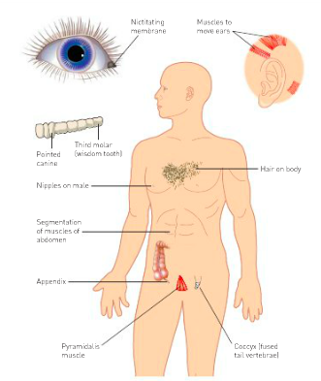
Examples of Vestigial Organs

